Slide 1
ASSOCIATION ANALYSIS
Association analysis is useful for discovering interesting relationship hidden in large data sets.
The uncovered relationships can be represented in the form of association rules or set off frequent items.
The association rule learning is the most important approach of machine learning, and it is employed in Market Basket analysis, Web usage mining, continuous production, etc. In market basket analysis, it is an approach used by several big retailers to find the relations between items.

Slide 2
Association Analysis: Association Analysis Is The Task Of Uncovering Relationships Among The hidden in large Dataset.
Association Rules: it is a model that identifies how the data itms are associated with each other.
Market Basket Analysis:
A huge amount of data is collected on movements of clients shopping in supermarkets and retail sector.
The most typical example of association rules is "market basket analysis" which is a modeling technique based on the idea that if one person buy a certain group of items, then he/she is more likely to buy (or not to buy) another group of items.
The discovery of this type of associations may provide important opportunity for market managers to develop more effective marketing strategies. For example, X% of customers buying sugar also buy eggs. This information can be found with association rule method.

Slide 3
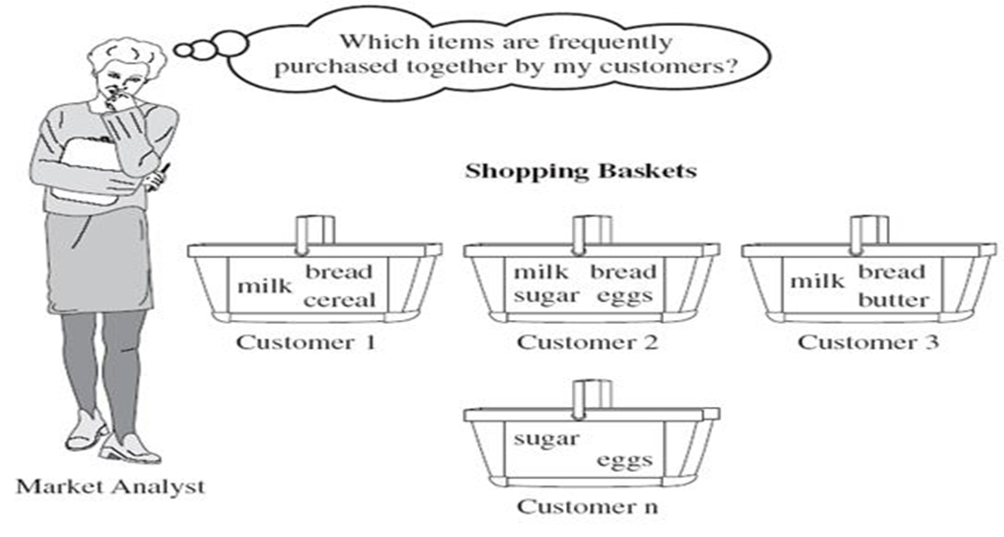

Slide 4
Association analysis is most widely used to discover hidden patterns in large data sets.
These hidden and uncovered relationships can be represented in the form of association rules or sets of frequent items.
The role of identifying interesting associations in large databases is correlation analysis.
There can be two types of these enthralling relationships: frequent itemsets or rules of the association.
object sets are a collection of objects that mostly take place together.
Association rules are the method of viewing fascinating relationships. The rules of association show that a close bond occurs between two or more objects

Slide 5
Market Basket Analysis
In transactional data, each case is connected with a set of objects. In principle, the list may contain all possible data items in the collection. For example - in a single market-basket analysis, goods with related items may be bought. However, only a small subset of all potential goods are present in a given set; only a small fraction of the items available for sale in the shop reflect the items in the market basket.
A common example of a regular pattern (item set) mining for association rules is market basket analysis. Business basket, the research analyzes the purchasing patterns of consumers by identifying correlations with the multiple items carried in their shopping baskets by customers.
An example of association rule - milk, bread
In a shop, if a shopkeeper sales milk then it is a probability to sell bread because a customer who is buying milk may also purchase bread. So it is showing that milk and bread are correlated with one another.

Slide 6
Association Rules techniques: Generate strong association rules from the frequent itemsets: those rules must satisfy minimum support and minimum confidence.
Type of Association Rules
1.Boolean AR:
it is a rule that checks whether an item is present or absent.
All the examples we have seen so far are Boolean AR.
2.Quantitative AR:
It describes associations between quantitative items or attributes.
Generally, quantitative values are partitioned into intervals.
Example:
Age(X,”30..39”) ∧ income(X,”80K..100K”)
➔ buys(X, High Resolution TV)

Slide 7
.Single-Dimension AR:
It is a rule that references only one dimension.
Example:
buys(X,”computer”)
➔ buys(X,”financial_software”)
The single dimension is “buys”
The following rule is a multi-dimensional AR:
Age(X,”30..39”)  income(X,”80K..100K”)
➔ buys(X, High Resolution TV)
4.Multi-level AR
• It is a set of rules that reference different levels of abstraction.
Example:
Age(X,”30..39”) ➔ buys(X, “desktop”)
Age(X,”20..29”) ➔ buys(X, “laptop”)
Laptop → desktop → computer

Slide 8
Applications of Association Rule Learning
It has various applications in machine learning and data mining. Below are some popular applications of association rule learning:
Market Basket Analysis: It is one of the popular examples and applications of association rule mining. This technique is commonly used by big retailers to determine the association between items.
Medical Diagnosis: With the help of association rules, patients can be cured easily, as it helps in identifying the probability of illness for a particular disease.
Protein Sequence: The association rules help in determining the synthesis of artificial Proteins.
It is also used for the Catalog Design and Loss-leader Analysis and many more other applications.

Slide 9
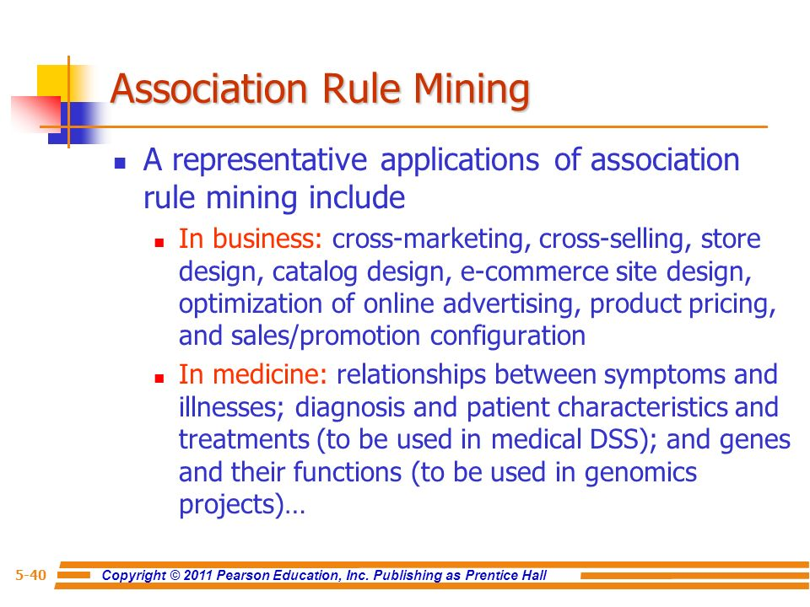

Slide 10
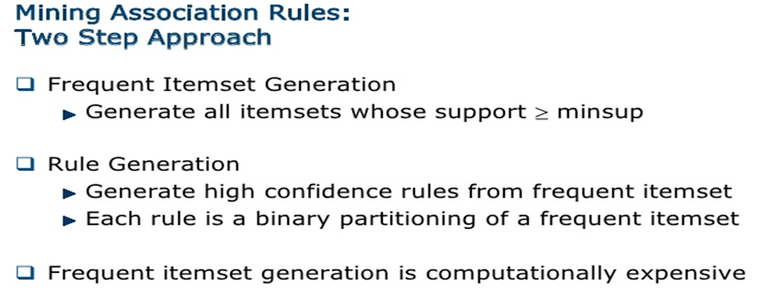

Slide 11
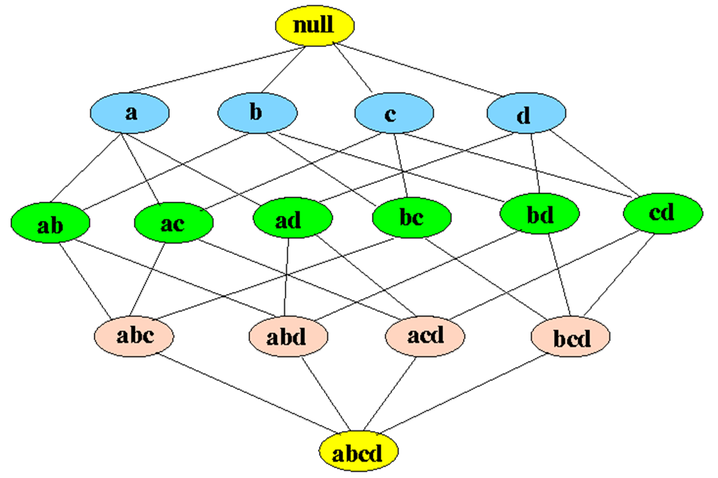
1.Frequent Itemset generation: Subsets and lattices A lattice structure can be used to enumerate the list of all possible subsets Example: all subset of {a,b,c,d} Given d items, there are 2^{d} possible candidate itemsets

Slide 12
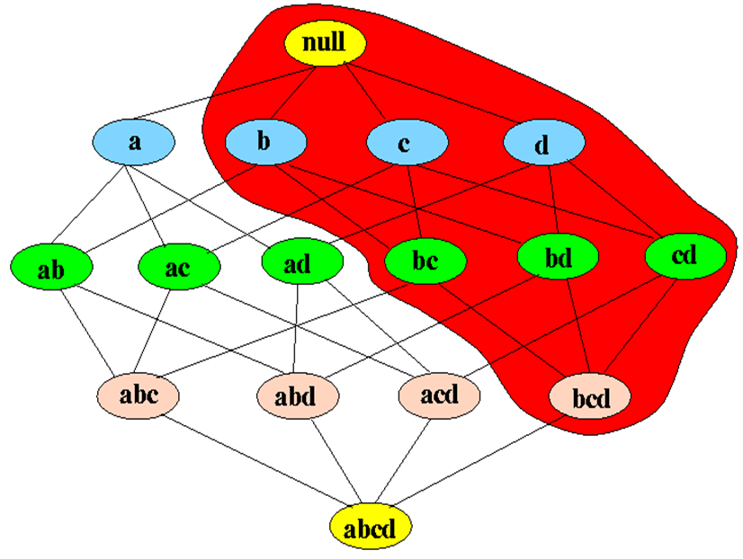
▪ If an itemset x is frequent (i.e., freq(x) ≥ θN), then: all subsets of x is also frequent
• Example: if {b,c,d} is frequent, then all subsets of {b,c,d} are also frequent

Slide 13
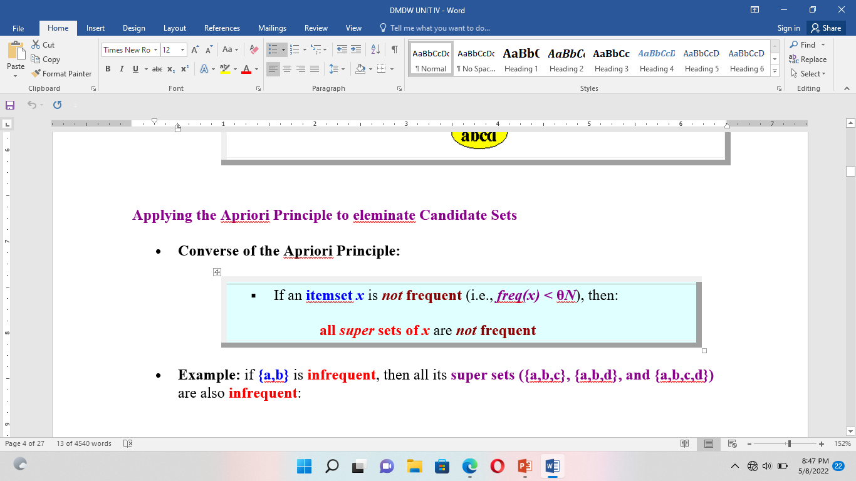

Slide 14
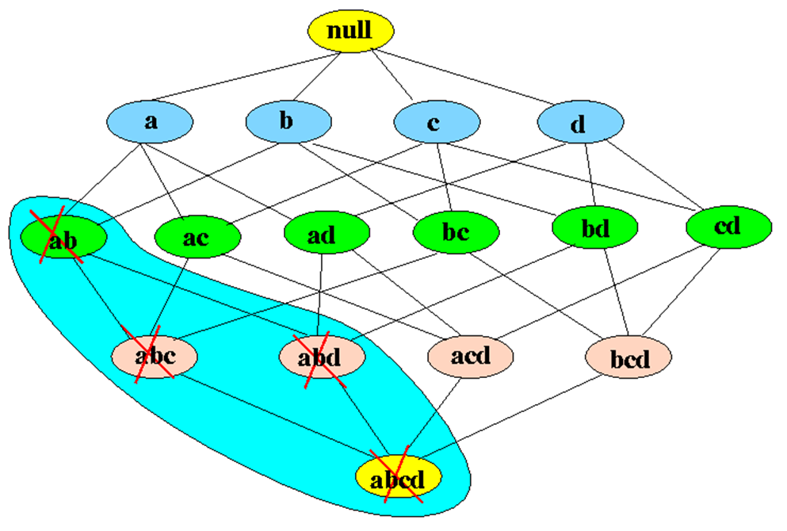

Slide 15
What is Frequent Item Set ?
It refers to set of items that frequently appear together and satisfies both minimum support threshold and minimum confidence threshold.
For example :Consider the below transaction where items A, B, C are brought together in first transaction (TID 1) , items A,B,D are brought together in second transaction (TID 2) and so on.
Given that minimum threshold support is 60% and minimum threshold confidence is 70%.
We can clearly see that items { B, C } has support (60%) >= minimum threshold support and confidence (75%) >= minimum threshold confidence . So { B, C } is a frequent item set.

Slide 16
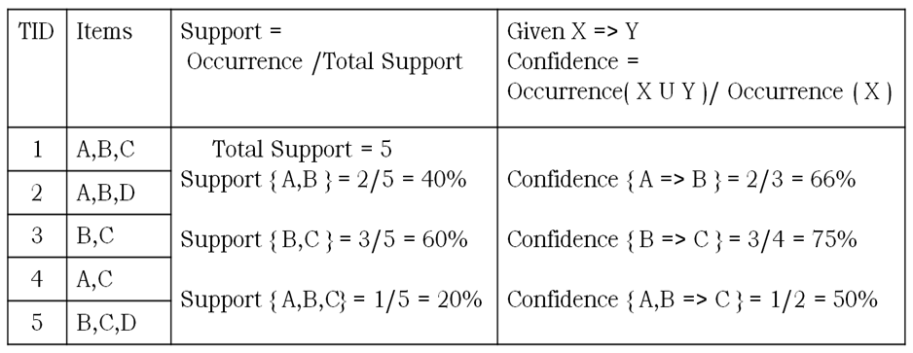

Slide 17
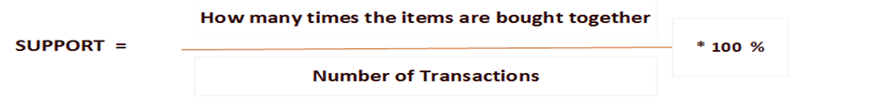
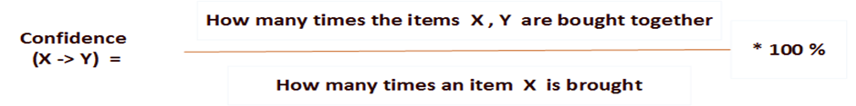
What is support :It is the percentage of the transaction, in which all the items in the item set is bought together.
For example :Consider the itemset { B, C } in the above transaction, as items B and C are bought together in 3 out of 5 transactions.
Support (B, C) = ( 3 / 5 ) * 100 % = 60%
Formulae: Support (A , B) = Probability(A U B)
What is confidence :The rule X => Y holds with confidence C if in C% of the transaction, customers who purchased a X also bought the Y.

Slide 18
For example :Consider the itemset { B, C } in the above transaction, As both items B and C are bought together in 3 transactions and item B is bought in 4 transactions.
Confidence (B -> C) = ( 3 / 4 ) * 100 % = 75%
Formulae: Confidence (A -> B) = Probability(A U B)/Probability(A) [7].
What is minimum support/confidence threshold ?
Association rules are considered interesting if they satisfy minimum support threshold and minimum confidence threshold which is set by users or domain experts. If an itemset I does not satisfy the minimum support threshold, then I is not frequent
Association Rule Mining Algorithms :this are two types
• Apriori Algorithm.: finding frequent item sets using candidate generation.
• FP Growth Algorithm.:finding frequent item sets using with out candidate generation.

Slide 19
Algorithm :
⇒ A priori is a seminal algorithm proposed by R.agarwal and R.srikanth in 1994 for mining frequent item set for boolen association rule.
⇒ Apriori employes an iterative approach known as level wise approach.
⇒ To improve the efficiency of the level wise generation of frequent item sets an important property called apriori property.
⇒ Apriori property:all non empty subsets of frequent item sets must be also frequent
It is a classic algorithm used in data mining for finding association rules based on the principle "Any subset of a large item set must be large". It uses a generate-and-test approach – generates candidate itemsets and tests if they are frequent.

Slide 20
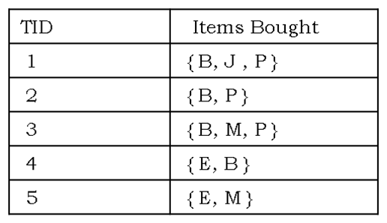
Frequent Itemset Generation:
Given the mininum threshold support, Generating large item sets (only keep frequent item sets – large item sets with enough support).
Illustration:Consider the below transaction in which B = Bread, J = Jelly, P = Peanut Butter, M = Milk and E = Eggs. Given that minimum threshold support = 40% and minimum threshold confidence = 80% [13].

Slide 21
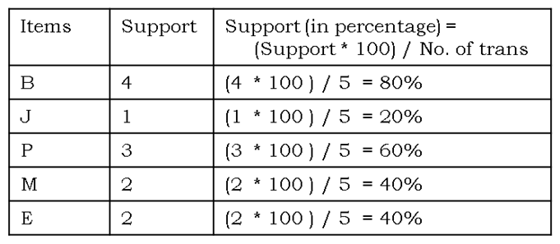
Step-1: Count the number of transactions in which each item occurs (Bread B occurs in 4 transactions and so on).

Slide 22
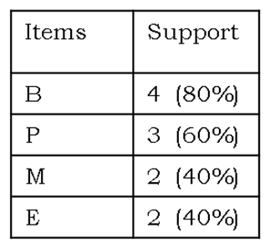
Step-2: As minimum threshold support = 40%, So in this step we will remove all the items that are bought less than 40% of support or support less than 2.
The above table has single items that are bought frequently. Now let’s find a pair of items that are bought frequently. We continue from the above table (Table in step 2)

Slide 23
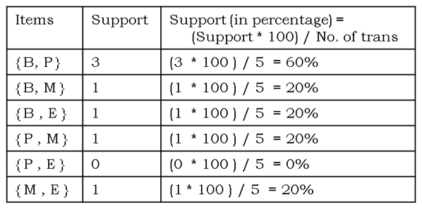
We start making pairs from the first item and below items like {B,P} ,{B,M} ,{B,E} and then we start with the second item and below items like {P,M} ,{P,E}. We do not make pair {P,B} because we already made {P,B} pair when we were making pairs of B. As buying a bread and Peanut Butter together is same as buying Peanut Butter and bread together. After making all the pairs we get,

Slide 24
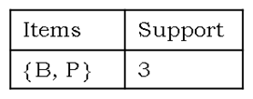
Step-4: As minimum threshold support = 40%, So in this step we will remove all the items that are bought less than 40% of support and we are left with
The above table has two items {B , P } that are bought together frequently.
Association Rule Generation :
Step-5: As we cannot generate large frequent item (itemset of 3) further because we are left with 1 frequent item set. We will start generating association rules from the frequent item set. As we have frequent item set of two, only two association rules will be generated which is shown below :

Slide 25
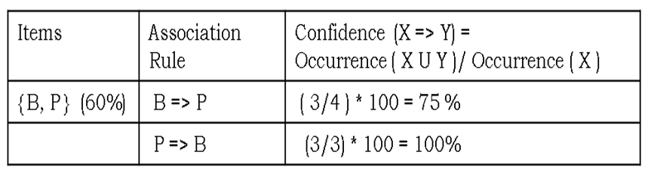
As P -> B has confidence 100% which is greater than minimum confidence threshold 80%, thus P -> B is a Strong Association Rule.
Disadvantages of Apriori Algorithm ?
• Generation of itemsets is expensive(in both space and time)
• Support counting is expensive

Slide 26
What is FP Growth Algorithm ?
An efficient and scalable method to find frequent patterns. It allows frequent itemset discovery without candidate itemset generation.
Following are the steps for FP Growth Algorithm
• Scan DB once, find frequent 1-itemset (single item pattern)
• Sort frequent items in frequency descending order, f-list
• Scan DB again, construct FP-tree
• Construct the conditional FP tree in the sequence of reverse order of F - List - generate frequent item set
Illustration:Consider the below tansaction in which B = Bread, J = Jelly, P = Peanut Butter, M = Milk and E = Eggs. Given that minimum threshold support = 40% and minimum threshold confidence = 80% [13].

Slide 27
Step-1: Scan DB once, find frequent 1-itemset (single item in itemset)

Slide 28
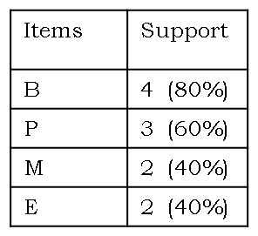

Step-2: As minimum threshold support = 40%, So in this step we will remove all the items that are bought less than 40% of support or support less than 2.
Step-3: Create a F -list in which frequent items are sorted in the descending order based on the support.
Step-4: Sort frequent items in transactions based on F-list. It is also known as FPDP.

Slide 29
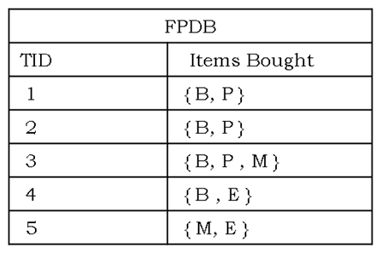
Step-5: Construct the FP tree
• Read transaction 1: {B,P} -> Create 2 nodes B and P. Set the path as null -> B -> P and the count of B and P as 1 as shown below :

Slide 30
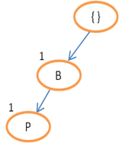
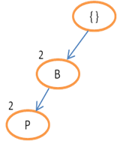
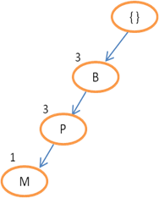
• Read transaction 2: {B,P} -> The path will be null -> B -> P. As transaction 1 and 2 share the same path. Set counts of B and P to 2.
• Read transaction 3: {B,P,M} -> The path will be null -> B -> P -> M. As transaction 2 and 3 share the same path till node P. Therefore, set count of B and P as 3 and create node M having count 1.

Slide 31
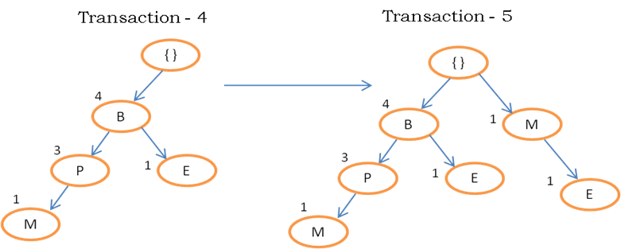
• Continue until all the transactions are mapped to a path in FP-tree.

Slide 32
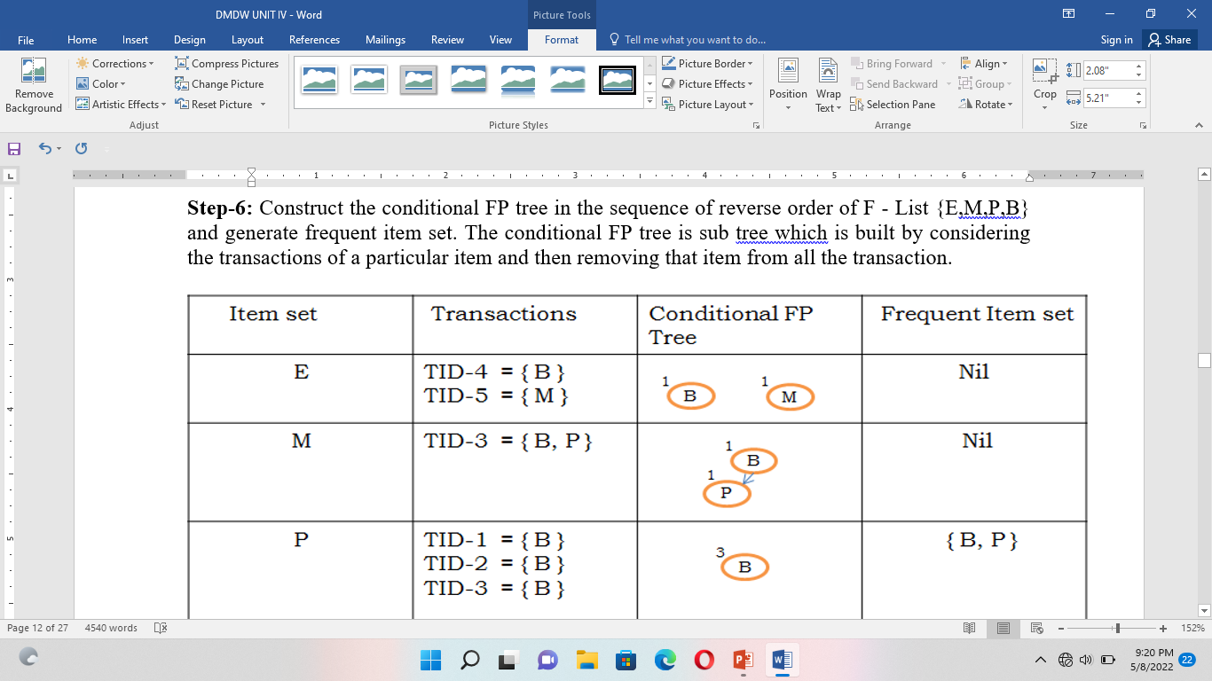

Slide 33
The above table has two items {B , P} that are bought together frequently.
As for items E and M, nodes in the conditional FP tree has a count(support) of 1 (less than minimum threshold support 2). Therefore frequent itemset are nil. In case of item P, node B in the conditional FP tree has a count(support) of 3 (satisfying minimum threshold support). Hence frequent itemset is generated by adding the item P to the B.

Slide 34
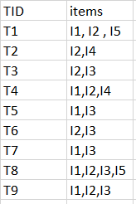

Slide 35
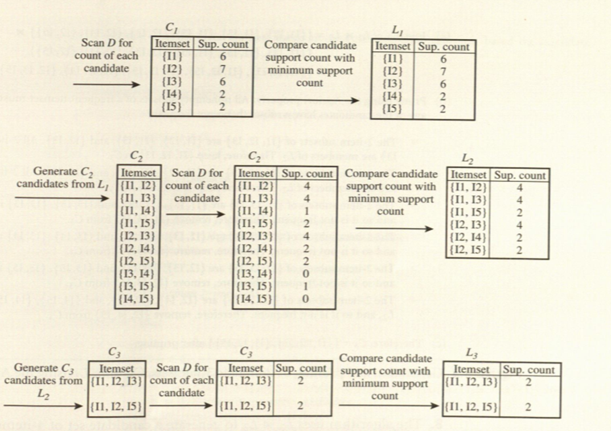

Slide 36
